Slide 1

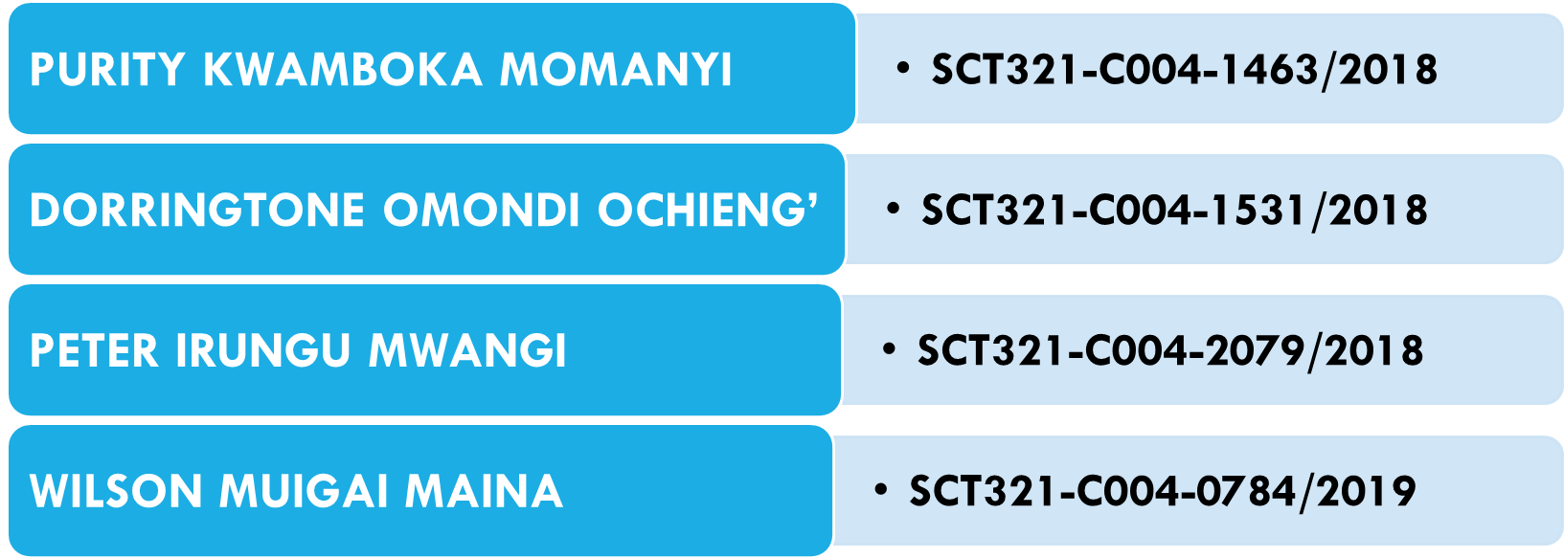
JOMO KENYATTA UNIVERSITY OF AGRICULTURE AND TECHNOLOGY
SCHOOL OF COMPUTING AND INFORMATION TECHNOLOGY
MIT 3110: INFORMATION MANAGEMENT
ASSIGNMENT 3 – GROUP WORK

Slide 2

Q1: DISCUSS INFORMATION TECHNOLOGY ARCHITECTURE.
Areas of focus
Introduction to Information Technology Architecture
Differentiate between the terms architecture and infrastructure
Definitions of terms and concepts
Business and IT Strategy Components
IT Architecture
Architectural Principles
Developing an IT Architecture Steps

Slide 3
Q2: DISCUSS INFORMATION TECHNOLOGY OPERATION AND OUTSOURCING.
Areas of focus
Information Technology Operations
Information Technology (IT) Outsourcing
Common outsourced IT services
Factors in the Outsourcing Decision
IT Outsourcing Risks
Decisions about How to Outsource Successfully

Slide 4
INTRODUCTION TO INFORMATION TECHNOLOGY ARCHITECTURE
In order to understand the concept of IT Architecture, we need first understand Information Management Technology, trickling down to managements of business and IT strategies where the IT Architecture falls. From the architecture, the business can then be translated into infrastructure.
(Pearlson, Saunders, & Galletta, 2016) notes that the terms architecture and infrastructure are often used interchangeably in the context of IS. However, two differ and each plays important role in realizing a business strategy. Architecture translates strategy into infrastructure.
For example, in building a house: The owner has a vision of how the final product should look and function. The owner must decide on a strategy about where to live-in an apartment or in a house.

Slide 5
INTRODUCTION CONT…D
The owner's strategy also includes deciding how to live in the house in terms of taking advantage of a beautiful view, having an open floor plan, or planning for special interests by designing such special areas as a game room, study, music room, or other amenities. The architect develops plans based on this vision. These plans, or blueprints, provide a guide-unchangeable in some areas but subject to interpretation in others-for the carpenters, plumbers, and electricians who actually construct the house. Guided by past experience and by industry standards, these builders select the materials and construction techniques best suited to the plan. The plan helps them determine where to put the plumbing and wiring, important parts of the home's infrastructure. When the process works, the completed house fulfils its owner's vision, even though he or she did not participate in the actual construction.

Slide 6
DEFINITIONS OF TERMS AND CONCEPTS
In a layman’s language, an architect is a person who designs buildings and in many cases also supervises their construction.
Definition from Techopedia: An IT architect is an individual that designs information technology solutions and services for organizations. They possess a strong business and IT background to architect software, hardware, network or any IT solution that gives the best results to the business. An IT architect is also known as an enterprise architect.
Based on the requirements and/or environment, an IT architect can create:
Software architectures, Network architectures, Enterprise application/ IT architectures, Security architectures, Database architectures
IT Architecture is the art and science of designing and delivering valuable technology strategy – Definition by Association For All IT Architects (IASA).
An architecture is a prudent management tool that will help ensure that IT is responsive to the organization’s business requirements.

Slide 7
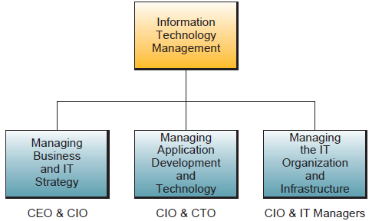
INFORMATION TECHNOLOGY MANAGEMENT
According to (O’Brien & Marakas, 2010), Information technology is an essential component of business success; however, that must be properly managed. The major components of IT management is as shown in the figure below.

Slide 8
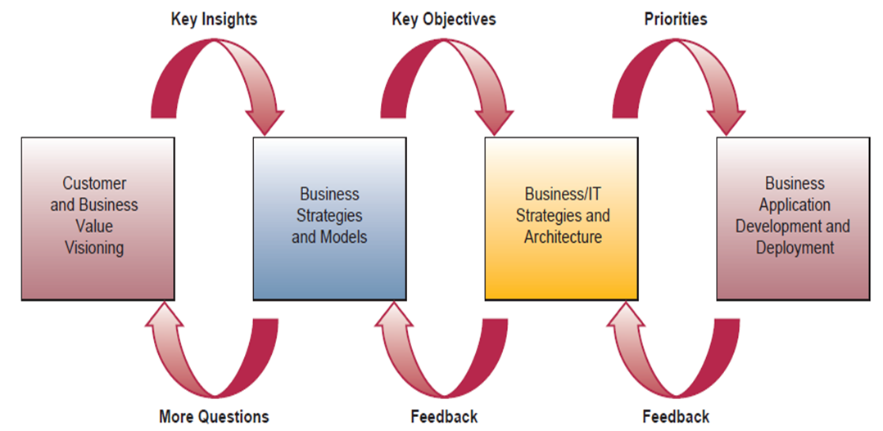
BUSINESS AND IT STRATEGY COMPONENTS
Business and IT strategy component encompasses the business/IT planning process, which focuses on discovering innovative approaches to satisfying a company’s customer value and business value goals. This planning process leads to the development of strategies and business models for new business applications, processes, products, and services. Then a company can develop IT strategies and an IT architecture that supports building and implementing its newly planned business applications.

Slide 9
IT ARCHITECTURE
The IT architecture created by the strategic business/IT planning process is a conceptual design, or blueprint, that includes the following major components (O’Brien & Marakas, 2010):
Technology Platform. The Internet, intranets, extranets, and other networks, computer systems, system software, and integrated enterprise application software provide a computing and communications infrastructure, or platform that supports the strategic use of information technology for e-business, e-commerce, and other business/IT applications.
Data Resources. Many types of operational and specialized databases, including data warehouses and Internet/intranet databases, store and provide data and information for business processes and decision support.
Applications Architecture. Business applications of information technology are designed as an integrated architecture or portfolio of enterprise systems that support strategic business initiatives, as well as cross-functional business processes.
IT Organization. The organizational structure of the IS function within a company and the distribution of IS specialists are designed to meet the changing strategies of a business. The form of the IT organization depends on the managerial philosophy and business/IT strategies formulated during the strategic planning process.

Slide 10
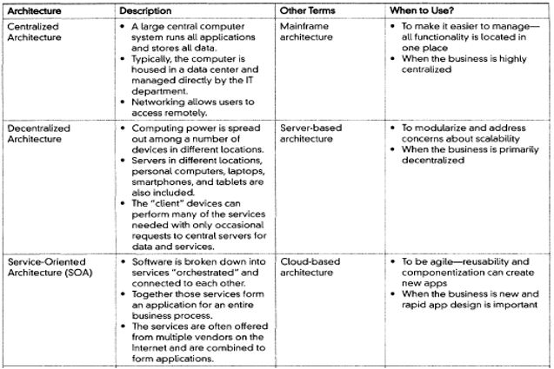
COMMON CONFIGURATIONS OF IT ARCHITECTURE
Traditionally, according to (Pearlson et al., 2016), there are three common configurations of IT architecture

Slide 11
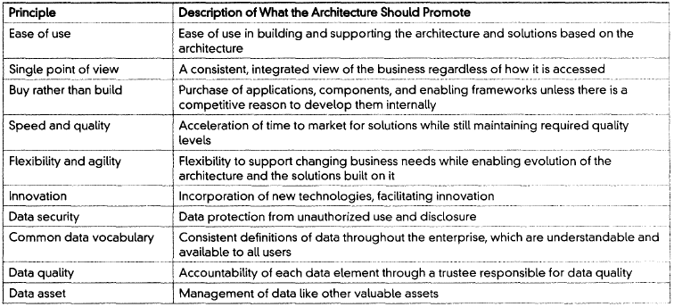
ARCHITECTURAL PRINCIPLES
Any good architecture is based on a set of principles, or fundamental beliefs about how the architecture should function

Slide 12
DEVELOPING AN IT ARCHITECTURE STEPS (OCKER, N.D.)
1. Articulate business strategy and implications for IT architecture - start from the top with the overall business strategy and its functional IT requirements
2. Baseline the company architecture baseline blueprint - assess existing IT bottom-up approach
3. Determine key architecture questions
    Outline set of questions to be answered, such as:
      What technologies do we have?, Are these the right technologies?, How does the current architecture support
      Our business?, Are we getting a strategic advantage from our architecture?
    Look into the future to the planned blueprint:
      In what technologies should we invest?, How should it be structured?
      How will it give us a competitive advantage?, Should we outsource any functions?
4. Design a planned architecture blueprint - decide what the architecture should be
5. Initiate the architecture plan - two approaches that can be used are revolutionary vs. evolutionary
  Revolution - radical replacement of old technology
  Evolution - new technology layered on top of existing infrastructure; old systems gradually replaced over time

Slide 13

INFORMATION TECHNOLOGY OPERATIONS

Slide 14
INFORMATION TECHNOLOGY (IT) OUTSOURCING
An increasingly popular approach to managing the IS and IT functions of the organization is to adopt an outsourcing strategy.
IT outsourcing is the contracting of IT functions, previously performed in-house, to an external service organization. Increasingly organizations are economically motivated to outsource portions of IT processes to focus on their core business.
This classic approach prevailed through most of the 1970s and 1980s but then experienced a decline in popularity. In 1989, Eastman Kodak Company's multivendor approach to meeting its IS needs created the "Kodak effect." Kodak outsourced its data centre operations to IBM, its network to Digital Equipment Company, and its desktop supply and support operations to Businessland. Kodak managed these relationships through strategic alliances.

Slide 15
MOST COMMON OUTSOURCED IT SERVICES
Application development and maintenance. When development and specific functionalities or modules within a software application are outsourced, the user entity should give priority to third-party software development firms with technical skill and experiential knowledge to address client specifications. Ongoing maintenance of existing applications and application upgrades should respond to software development recommendations by the business process users and stakeholders.
Infrastructure management. These include network management, maintaining overall infrastructure performance and availability, disaster recovery strategies and capabilities, troubleshooting errors, maintaining databases, and backing up and restoring services. More recent and value-added services are the monitoring of IT infrastructure activities and capacity management, performing of downtime analyses, and reporting of critical system failures and their implications.
Help desk. Any maintenance service, such as troubleshooting problems, production support, and infrastructure management, can be categorized as a help desk service. Under this arrangement, the service provider’s personnel support the client through various IT problems either on site or off site. Turn-around time (TAT is then defined for each level of service.
Independent testing and validation. Many organizations outsource the testing and validation of software developed in-house or by a third party. Specialized testing of the developed system is used to monitor the system’s performance and identify and track programming errors or problems to resolution.

Slide 16
CONT….D
Systems integration. In a decentralized environment, various functions are organized through disparate systems and applications that may not talk to each other. Decentralized environments require more human intervention to perform system and application updates, clear out-of-balance conditions, data sources, and detect erroneous results. System integration services involve the development of scripts, modules, tools, or programs to integrate multiple applications and systems. This enables existing applications to communicate with one another seamlessly, resulting in one consolidated system.
Research & Development. To adapt and innovate to meet market needs while continuing to build and maintain business intelligence databases, many organizations outsource the research and development of different technologies, solutions, processes, and systems..
Managed security. Many organizations outsource security services. This outsourcing area also is called managed security services (MSS) due to the service provider’s management of an organization’s third-party security requirements.
Cloud computing. Cloud computing provides scalable and often virtualized computing resources to fill a business need on demand. Cloud computing provides servers, storage, and computer power as a service rather than a product. Resources, software, and other information are provided dynamically like a utility over a network, often the Internet.

Slide 17
FACTORS IN THE OUTSOURCING DECISION
(Pearlson et al., 2016) notes the following as factors that are likely to favour the decision to seek to buy the services or products of an outsourcing provider:
Lower costs due to economies of scale: Outsourcing providers derive savings from economies of scale that client companies often cannot realize. Outsourcing providers achieve these economies through centralized (often "greener") data centres, preferential contracts with suppliers, and large pools of technical expertise. Most often, enterprises lack such resources on a sufficient scale within their own IS departments.
Ability to handle processing peaks: The outsourcing provider's larger pool of resources than the client company's allows the provider leeway in assigning available capacity to its clients on demand. For instance, at year-end, an outsourcing provider potentially can allocate additional mainframe capacity to ensure timely completion of nightly processing in a manner that would be impossible for an enterprise running its own bare-bones data centre.
The client company's need to consolidate data centres: An outsourcing provider may help a client company to consolidate data centres following a merger or acquisition or when the internal group cannot overcome the inertia of its top management.

Slide 18
CONT..D
(O’Brien & Marakas, 2010) adds the following factors as contributors to outsourcing:
Focus on Core Competencies: Outsourced professionals allow an organization and its employees to focus on the business they are in rather than a business in which they are not. By using an outsourcing strategy for application development, an organization can focus its IS professionals on identifying and solving business problems rather than on programming and prototyping new applications.
Achieve Flexible Staffing Levels: Strategic use of an outsourcing approach to IS/IT functions can result in business growth without increasing overhead. Outsourcing provides a pool of qualified professionals available for unique, niche, or overflow projects. If the unique skill set required by an organization is difficult to find or expensive to maintain in-house, outsourcing can allow for the acquisition of the needed expertise.
Decrease Time to Market: Outsourcing extends the traditional small business benefits of flexibility and responsiveness, allowing smaller organizations to compete effectively against bigger firms. Supplementing an existing workforce with offshore support could allow for productivity 24 hours a day. Having access to resources able to work on key projects even while local employees are asleep can serve to accelerate time to market and provide a key competitive advantage.

Slide 19
IT OUTSOURCING RISKS
Opponents of outsourcing cite a considerable number of risks with it. A manager should consider each of these before making a decision about outsourcing. Each risk can be mitigated with effective planning and ongoing management (Pearlson et al., 2016).
  Outsourcing requires that a client company surrender a degree of control over critical aspects of the enterprise. The potential loss of control could extend to several areas: project control, scope creep, technologies employed, costs, financial controls, accuracy and clarity of financial reports, and even the company's IS direction. A manager must choose an outsourcing provider carefully and negotiate terms that encourage an effective working relationship.
  Outsourcing client companies may not adequately anticipate new technological capabilities when negotiating outsourcing contracts. Outsourcing providers may not recommend so-called bleeding-edge technologies for fear of losing money in the process of implementation and support, even if their implementation would best serve the client company. Thus, poorly planned outsourcing can result in a loss in IS flexibility. To avoid this problem, an outsourcing client should have a chief technology officer (CTO) or technology group that is charged with learning about and assessing emerging technologies that can be used to support its company's business strategy.

Slide 20
CONT….D
3. Contract terms may leave client companies highly dependent on their outsourcing provider with little recourse in terms of terminating troublesome provider relationships. That is, the clients may be locked into an arrangement that they no longer want. It may be too expensive to switch to another outsourcing provider should the contract sour. Despite doing due diligence and background checks, the outsourcing provider may be unreliable or go out of business before the end of the contract. The risk of over-reliance for any number of reasons typically increases as the size of the outsourcing contract increases.
4. It might be harder to keep its competitive secrets when a company employs an outsourcing provider. Although outsourcing providers are sensitive to keeping client information separated in their systems, an outsourcer's staff will usually work with multiple customers. Some managers are concerned that their company databases are no longer kept in house, and the outsourcing provider's other customers may have easier access to sensitive information.
5. The outsourcing provider's culture or operations may be incompatible with that of the client company, making the delivery of the contracted service or system difficult. Conflicts between the client's staff and the staff of the outsourcing provider may delay progress or harm the quality of the service or product delivered by the outsourcing provider.

Slide 21
DECISIONS ABOUT HOW TO OUTSOURCE SUCCESSFULLY
Clearly, the decision about whether to outsource must be made with adequate care and deliberation. Three major decision areas are selection, contracting, and scope (Pearlson et al., 2016).
  Selection: Selection-related decisions focus on finding compatible outsourcing providers whose capabilities, managers, internal operations, technologies, and culture complement those of the client company. This means that compatibility and cultural fit might trump price, especially when long-term partnerships are envisioned.
  Contracting: Client companies must ensure that contract terms allow them the flexibility they require to manage and, if necessary, sever supplier relationships. Often client companies and outsourcing providers have formal outsourcing arrangements, called service level agreements (SLAs) that define the level of service to be provided. SLAs often describe the contracted delivery time and expected performance of the service. Contracts are tightened by adding clauses describing actions to be taken in the event of a deterioration in quality of service or noncompliance with the SLA. Service levels, baseline period measurements, growth rates, and service volume fluctuations are specified in the contracts to reduce opportunistic behaviour on the part of the outsourcing provider.

Slide 22
CONT….D
Scope: Most enterprises outsource at least some IS functions. This is where scope questions come into play. Defining the scope of outsourcing means that the client must decide whether to pursue outsourcing fully or selectively with one (single sourcing) or more providers (multi-sourcing). If a client decides to go the selective outsourcing route, it may insource most of its IS duties but selectively outsource the remaining functions.
  Full outsourcing implies that an enterprise outsources all its IS functions from desktop services to software development. An enterprise typically outsources everything only if it does not view IT as a strategic advantage.
  With selective outsourcing (also called strategic sourcing), an enterprise chooses which IT capabilities to retain in house and which to give to one or more outsiders. A "best-of-breed" approach is taken to choose suppliers for their expertise in specific technology areas. Possible areas for selective sourcing include Web site hosting, Web 2.0 applications, cloud services, business process application development, help desk support, networking and communication, social IT services, and data centre operations. Selective outsourcing reduces the client company's reliance on outsourcing with only one provider and provides greater flexibility and often better service due to the competitive market.

Slide 23
REFERENCES
Ame, B. C., Brown, F., Deboer, J., Tai, D., Lynn, M., & Martinez, C. L. (2012). Information Technology Outsourcing (2nd ed.). Altamonte Springs, Fla: The Institute of Internal Auditors. Retrieved from https://chapters.theiia.org/montreal/ChapterDocuments/GTAG%207%20-%20Information%20technology%20outsourcing_2nd%20ed.pdf
Coman, A., & Ronen, B. (1995). Information technology in operations management: a theory-of-constraints approach. International Journal of Production Research, 33(5), 1403–1415. https://doi.org/10.1080/00207549508930217
Ilkevicius, A. (2008). Enterprise Architecture: Concept and Practice. IBM Corporation.
O’Brien, J. A., & Marakas, G. M. (2010). Management Information Systems (10th ed.). 1221 Avenue of the Americas, New York, NY, 10020.: McGraw-Hill/Irwin,. Retrieved from http://fumblog.um.ac.ir/gallery/652/James_OBrien,_George_Marakas_Management_Information_Systems,_10th_Edition______2010.pdf
Ocker, R. (n.d.). Managing Information: Information Technology Architecture.
Pearlson, K. E., Saunders, C. S., & Galletta, D. F. (2016). Managing and Using Information Systems A Strategic Approach, 6th Edition (6th ed.). Hoboken, NJ: John Wiley & Sons, Inc.

